Slide 1
CSE 518A Human-in-the-Loop Computation
Instructor: Chien-Ju (CJ) Ho

Slide 2
Course Information
Announcements and discussion
Website: http://chienjuho.com/courses/cse518a
Piazza: http://piazza.com/wustl/fall2022/cse518a
Please check the website and Piazza regularly
Time and location
Tue/Thu 4:00-5:20pm
Hillman 70

Slide 3
Plan for today
Welcome and introduction
What’s the class about?
Logistics

Slide 4
Human-in-the-Loop Computation?
Notes:
https://wheelofnames.com/myd-yap

Slide 5

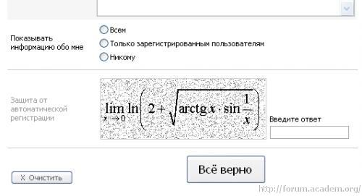
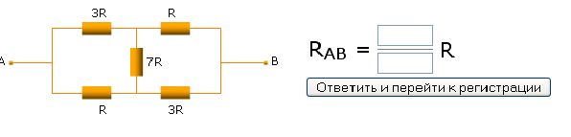

CAPTCHA
Completely Automated Public Turing test to tell Computers and Humans Apart
Humans
V4XBG
Bots
?????
A

Slide 6
Roughly 200 million CAPTCHAs are typed every day*
10s of human time per CAPTCHA
*statistics around 2011
Can we utilize this wasted human computation power?

Slide 7
What are humans doing for solving CAPTHCAs?
Solving tasks that AIs cannot do well yet
Optical Character Recognition (OCR)
Hard for AI (used to be but not anymore)
Relatively Easy for humans
Can we utilize CAPTCHAs to help solve OCR tasks?

Slide 8

Word 1: an OCR task to solve Word 2: tell apart humans and bots
“reCAPTCHA has completely digitized the archives of The New York Times and books from Google Books, as of 2011”
von Ahn et al. reCaptcha: Human-based Character Recognition via Web Security Measures. Science, September 2008

Slide 9
More than OCR
Google acquired reCAPTCHA in 2009.

Slide 11
The lawsuit was tossed by the judge. But ethical considerations (e.g., fairness, privacy) are important issues to consider in human-in-the-loop computation.

Slide 12
Are there other examples of human-in-the-loop computation?

Slide 13


Slide 14

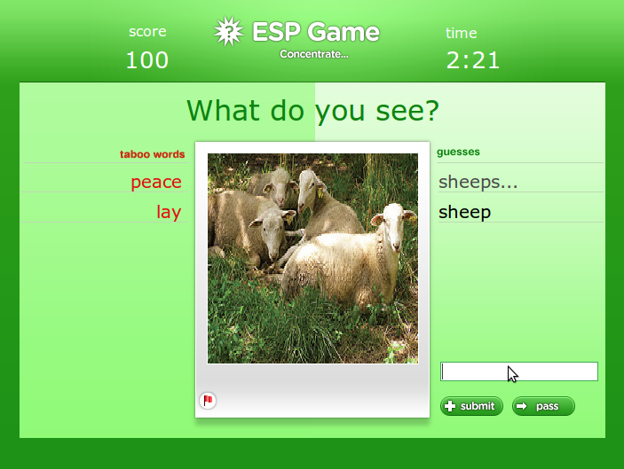
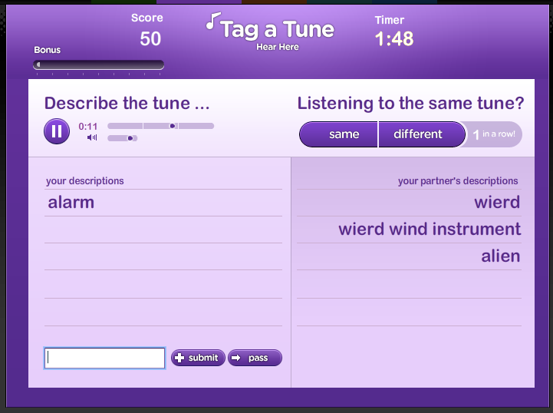
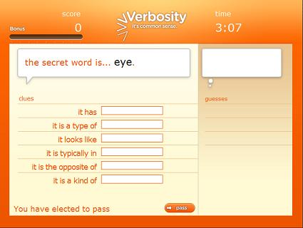
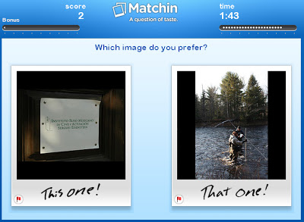


von Ahn and Dabbish. “Labeling Images with a Computer Game”. 2004.

Slide 15

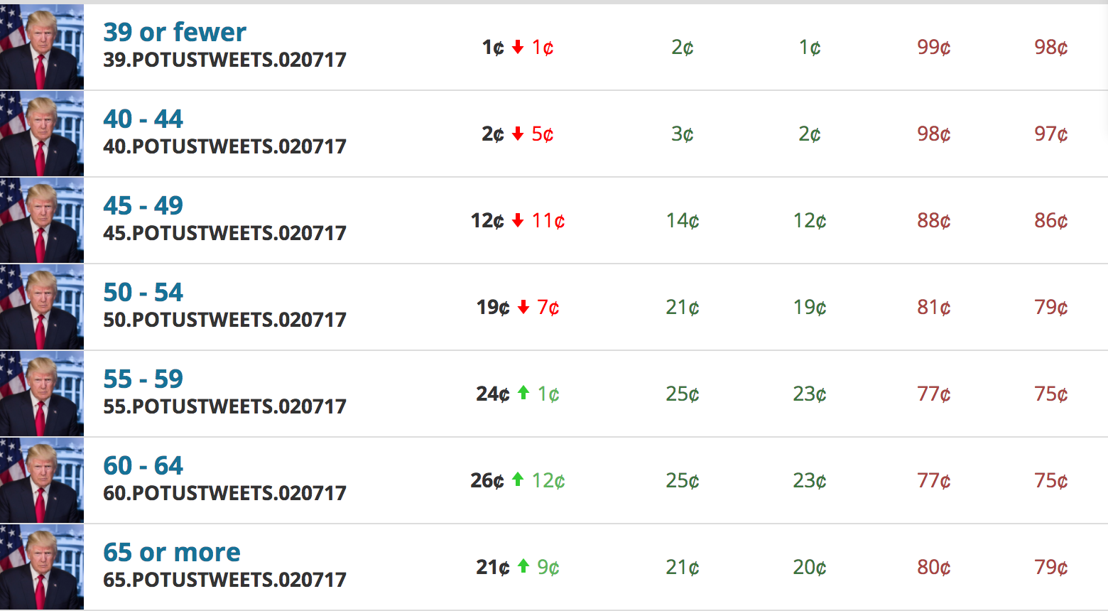

Slide 16
Education

Slide 17

General-Purpose Platform: Crowdsourcing Markets
Post Tasks:
Specify payments
Audio transcription
Image tagging
Relevance evaluation
Handwriting recognition
Product information collection

Slide 18

















In fact, a lot more…

Slide 19
What is this course about?
Study the design and analysis of human-in-the-loop computation.
Will cover research papers from a wide spectrum of research fields, including machine learning, economics, optimization, and human-computer interactions.
Human as data sources:
Label aggregation
Probabilistic reasoning to aggregate noisy human data
Practical challenges:
Complex tasks and teams
Studies on workflow and team designs from HCI perspective
Humans are “Humans”:
Incentive design
Game theoretical modeling of humans and incentive design
Selected recent topics:
Ethical issues of AI/ML, learning with strategic behavior, Human-AI collaborations.

Slide 20
Let’s take a look at the course schedule
http://chienjuho.com/courses/cse518a

Slide 21
Logistics

Slide 22
Grading
Course Project: 40%
Homework assignment: 20%
4 homework assignments
Paper reviews and class participation: 20%
Paper presentation and leading of discussion: 20%

Slide 23
Course Project
The main component of the course.
Could be an original research project or an extensive literature survey.
You are encouraged to start with a research project. You will have the chance to convert the project to literature review if things don’t go well.
Tentatively, you should work in groups of 2 (or 3 if the class size is large).
Will announce the detailed guidelines next week after the class size is finalized.

Slide 24
Tentative Timeline of Project
Sep 24: Project proposal (and deciding team members)
Brief description of the proposed project (1~2 paragraph)
Citing at least one paper that’s relevant to your proposal
Oct 14: Milestone 1
A brief literature review and the description of your plan (one page)
Last chance to change the topic of the project
Nov 4: Milestone 2
Summary of your current progress (up to 2 pages)
Last chance to convert the research project to (a more extensive) literature review
Dec 6/8: In-class project presentations
Dec 9: Project report due

Slide 25
Grading
Course Project: 40%
Homework assignment: 20%
4 homework assignments
Paper reviews and class participation: 20%
Paper presentation and leading of discussion: 20%

Slide 26
Homework Assignments
Assignment 1
Be a crowdsourcing worker and write a report
Assignment 2
Programming assignment
Implement label aggregation algorithms covered in class on a given dataset
Assignment 3
Math assignment
Using game theory to analyze some given human-in-the-loop mechanisms
Assignment 4
TBD
No TA in this course
You are expected to be able to work independently

Slide 27
Grading
Course Project: 40%
Homework assignment: 20%
4 homework assignments
Paper reviews and class participation: 20%
Paper presentation and leading of discussion: 20%

Slide 28
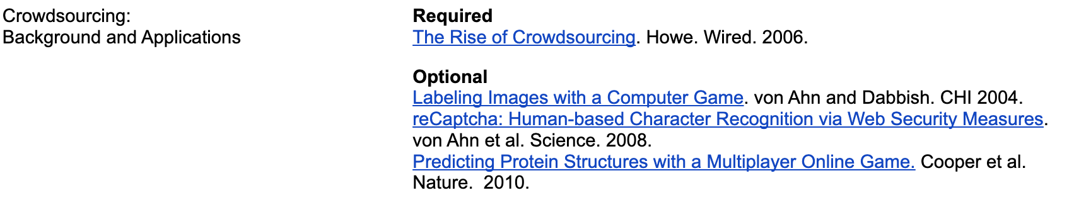
Paper Reviews and Class Participation
Before each lecture, finish the required reading and submit a review (including a summary and answers to additional questions).
Due by the midnight before each lecture on Gradescope.
Exception: the review for the next lecture is due at 2pm the day of the lecture

Slide 29
Required Reading and Review
You should be ready to answer the following questions:
Summary the paper in 3~4 sentences.
What’s the research question the paper is solving?
What’s the proposed approach?
What are the results?
Illustrate what you like/dislike about the paper.
Answer additional questions related to the paper.
Try also to think about your project during reading
It might be hard in the beginning. Try to think about what assumptions they make, and whether you can relax some of those? Can you apply the method/approach of the paper in different domains/applications, etc?

Slide 30
Class Participation
Participation is important for this course
I plan to enforce the participation requirement
A non-linear grading scheme
Most students will either get full credits or 0 credits for participation.
Examples:
Attend every lecture but rarely participate in discussion: 0 credits for participation
Attend less than 60~70% of the lectures: 0 credits for paticipation

Slide 31
Grading
Course Project: 40%
Homework assignment: 20%
4 homework assignments
Paper reviews and class participation: 20%
Paper presentation and leading of discussion: 20%

Slide 32
Paper Presentations and Leading of Discussion
You will need to sign up to present the paper(s) and lead the discussion, in groups of 2~3 students (again, more to come next week).
Take a look at the current schedules
Presenters:
Read the required paper and additional optional papers for the assigned class
Discuss with me (one week before class) about the presentation and the reading questions
We will talk more about the presentation format next week
Non-presenters:
Submit reviews on time and engage in the discussion in class.

Slide 33
Grading
Course Project: 40%
Homework assignment: 20%
4 homework assignments
Paper reviews and class participation: 20%
Paper presentation and leading of discussion: 20%

Slide 34
More on The Grades
Homework assignments / reviews will be lightly graded
Condition on you complete all other requirements satisfactorily, your final grades are determined by your final project
A+: Your project is close to be published in top venues
A: I’m happy to use your project as model projects in the future
A-: Overall good, but there are minor flaws (in reports/presentation/approaches/…)
B+ or lower: There are more significant flaws in the project (e.g., poorly motivated problems, etc)
Your final grades will be decreased from the above for missing reviews / homework issues / non-participation using the grading scheme (following the standard mapping)

Slide 35
Collaboration and Late-Day Policy
Collaboration policy
You are encouraged to collaborate, but all assignments must be written down on your own.
Late day policy
Assignments
4 late days in total. No 2 late days per assignment.
Reviews
No late submissions. But you can skip 2 of them without penalty.
Project-related reports
No late submissions.

Slide 36
Next lecture:
Read the required reading of next lecture and submit the review!
Please submit the review on time so I can get a better sense of how many students will stay in the course.
You cannot apply the late-day rule and skip this review.

Slide 37
Another thing to do
Register as a worker in one of the crowdsourcing platforms
Amazon Mechanical Turk: https://www.mturk.com/worker
Recommended, but they don’t approve all registration requests
Appen: https://appen.com/jobs/
microWorkers: https://www.microworkers.com/faq.php
Clickworker: https://www.clickworker.com/clickworker
You need to be a worker and complete tasks for Assignment 1
Do it early, and let me know if there are any issues in the process
The registration process could take several business days
It’s likely Amazon will deny registration

Slide 38
Is the course for you?
Need to be comfortable with several math concepts and basic programming
Probability
linear algebra
calculus
basic concepts about computer science and ability to program
If you are not sure, please take a peek at the papers from Sep 8 – 29
You should at least be able to understand the formulation and main results
You will need to implement some algorithms in these papers

Slide 39
Questions?

